Slide 1
MGT 401 Foundations of Management & Organizational Behaviour
Topic: Management level
Dr. C. Vijaya Banu
Associate Professor , School of Management
SASTRA Deemed University, Thanjavur – 613 401
vijayabanu@mba.sastra.edu

Slide 2
Levels of Management
The term “Levels of Management’ refers to a line of demarcation between various managerial positions in an organization.
 The number of levels in management increases when the size of the business and work force increases and vice versa.
 The level of management determines a chain of command, the amount of authority & status enjoyed by any managerial position.
The levels of management can be classified in three broad categories: -
 Top level / Administrative level.
 Middle level management.
 Low level / Supervisory.

Slide 3
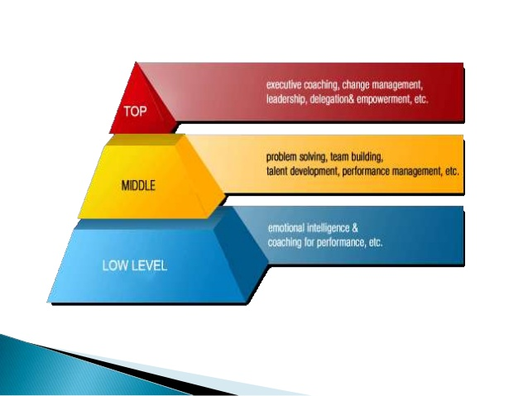

Slide 4
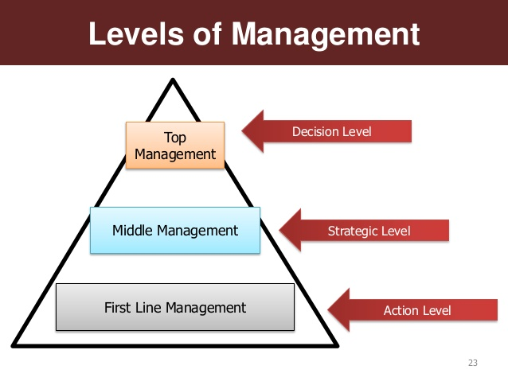

Slide 5
Classifying Managers
First-line Managers
Individuals who manage the work of non-managerial employees.
Middle Managers
Individuals who manage the work of first-line managers.
Top Managers
Individuals who are responsible for making organization-wide decisions and establishing plans and goals that affect the entire organization.

Slide 6
How to classify managers in organizations?
Traditional Pyramid Form of Management Level
Top Managers
Middle Managers
First-Line Managers
Non-Managerial
Employees
Functional Areas
R&D Marketing Finance Production HR

Slide 7
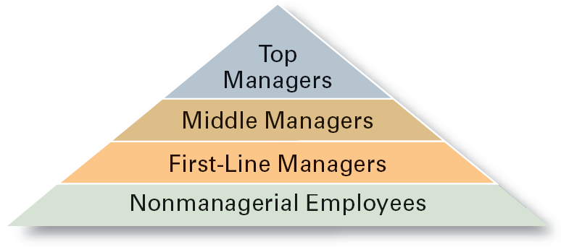
Managerial Levels

Slide 8
Top management lays down the objectives and broad policies of the enterprise. ◦ It issues necessary instructions for preparation of department budgets, procedures, schedules etc. ◦ It prepares strategic plans & policies for the enterprise. ◦ It appoints the executive for middle level i.e. departmental managers
The branch managers and departmental managers constitute middle level. They are responsible to the top management for the functioning of their department. They devote more time to organizational and directional functions. In small organization, there is only one layer of middle level of management but in big enterprises, there may be senior and junior middle level management.
Lower level is also known as supervisory / operative level of management. It consists of supervisors, foreman, section officers, superintendent etc. According to R.C. Davis, “Supervisory management refers to those executives whose work has to be largely with personal oversight and direction of operative employees”. In other words, they are concerned with direction and controlling function of management.

Slide 9
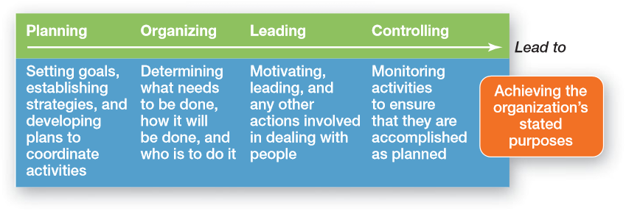
Management Functions

Slide 10
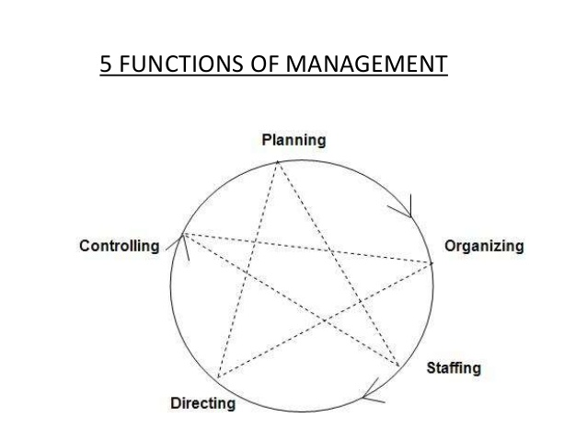
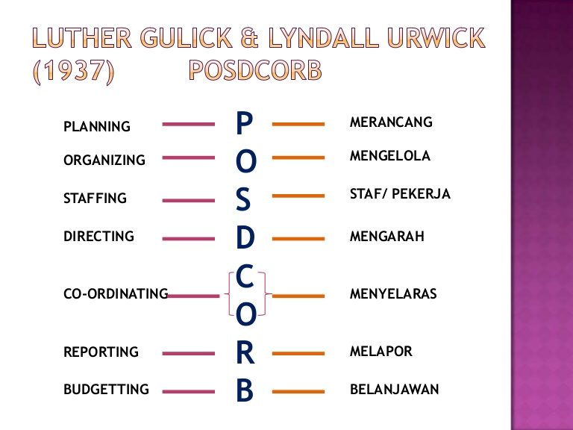

Slide 11
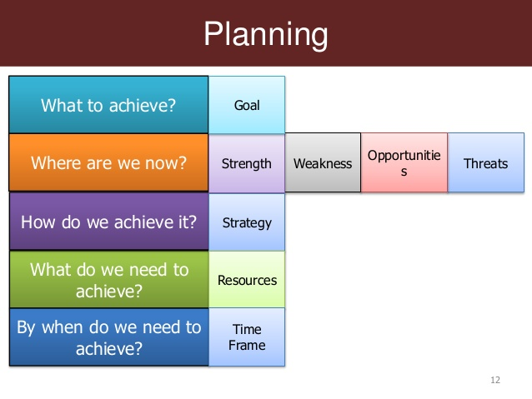

Slide 12
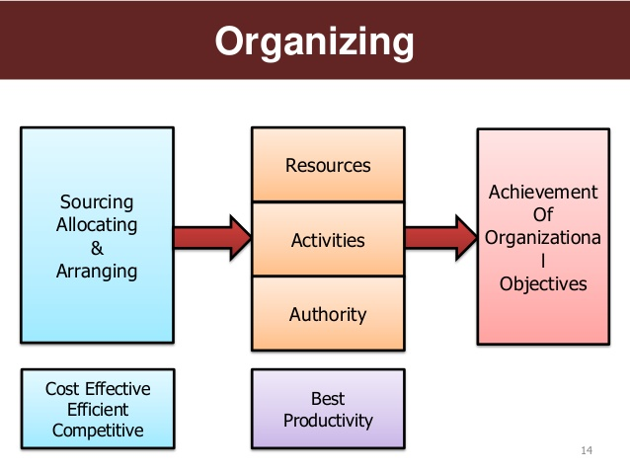

Slide 13
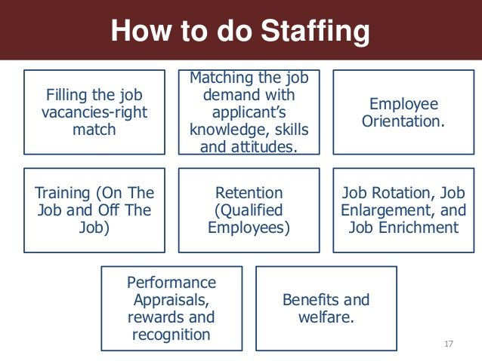

Slide 14
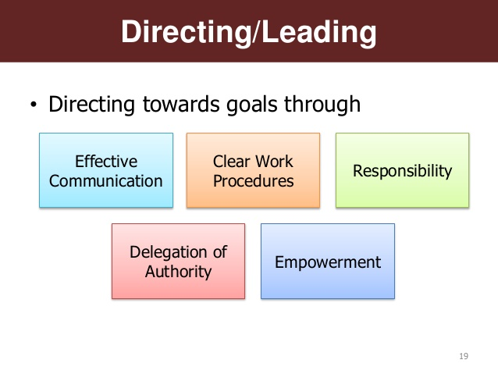

Slide 15
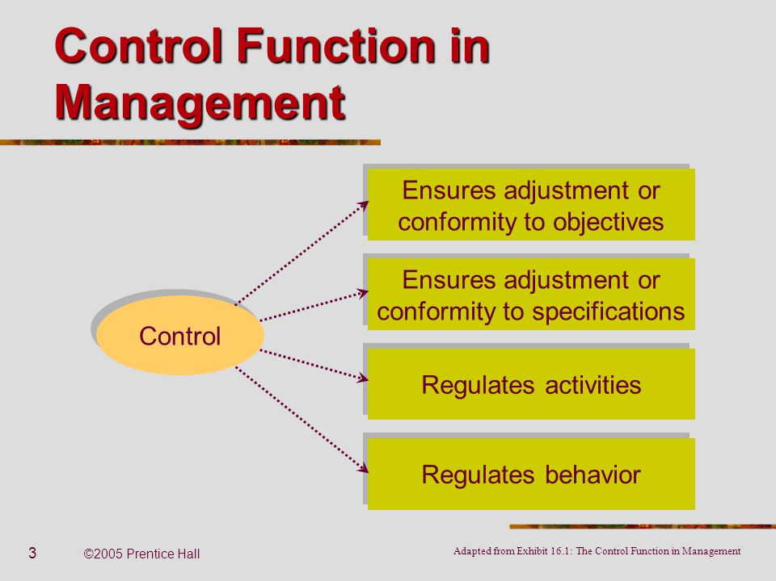

Slide 16
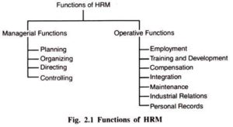

Slide 17
